Slide 1

Lecture Notes on Financial Reporting and Corporate Strategy
A Contemporary Studies
Presented by Dr. Daniel Cheung

Slide 2
A brief introduction of Dr. Daniel Cheung
Dr. Daniel Cheung holds a doctorate degree in financial economics from Southern Illinois University at Carbondale, USA. Dr. Cheung has more than thirty years of teaching experience in universities in Hong Kong. In particular, Dr. Cheung has been teaching and conducting research at the Chinese University of Hong Kong for about twenty years. Recently, Dr. Cheung is a consultant of pre-IPOs as well as project finance; and he is also a part-time lecturer in DBA/MBA/BBA finance and economics courses. Dr. Cheung has published more than ten papers in international academic journals.

Slide 3
Definition of Financial Reporting
Financial Reporting involves the disclosure of financial information to the various stakeholders about the financial performance and financial position of the organization over a specified period of time.
  Stakeholders include – investors, creditors, public, debt providers, governments & government agencies. In case of listed companies the frequency of financial reporting is quarterly & annual.

Slide 4
Financial Reporting is usually considered an end product of Accounting.
The typical components of financial reporting are:
The financial statements – Balance Sheet, Profit & loss account, Cash flow statement & Statement of changes in stock holder’s equity
The notes to financial statements
Quarterly & Annual reports (in case of listed companies)
Prospectus (In case of companies going for IPOs)
Management Discussion & Analysis (In case of public companies)

Slide 5
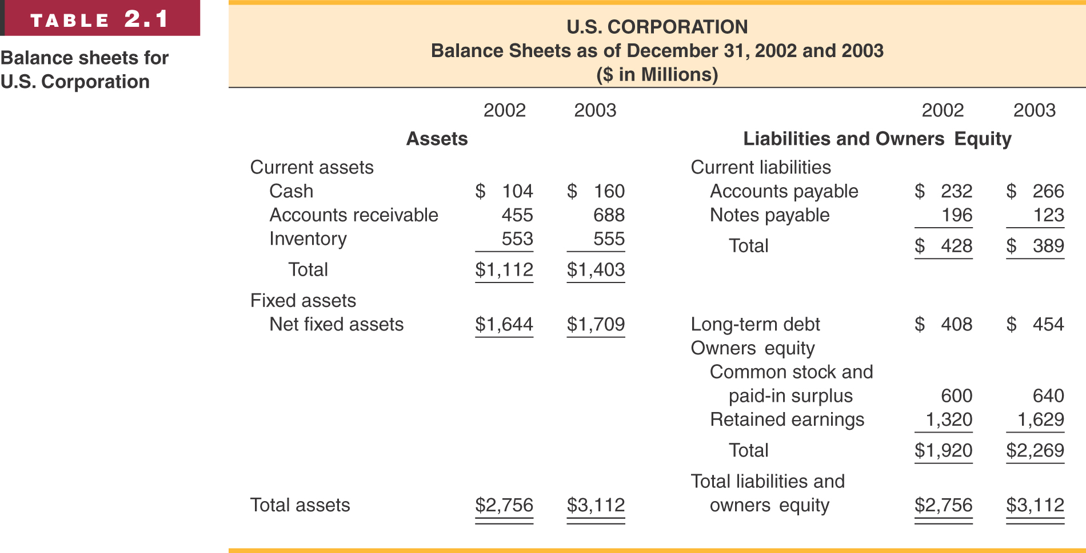
ABC Corporation
Balance Sheet as Dec. 31, 2018 and 2019
($ in Millions)
2018
2019
2018
2019

Slide 6
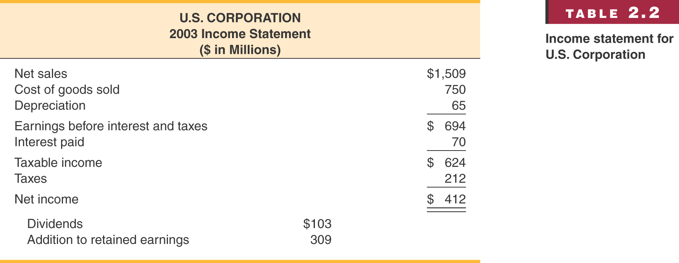
ABC Corporation
2019 Income Statement
($ in Millions)

Slide 7
Objectives of Financial Reporting
According to International Accounting Standard Board (IASB), the objective of financial reporting is “to provide information about the financial position, performance and changes in financial position of an enterprise that is useful to a wide range of users in making economic decisions.”

Slide 8
The following are the sum up the objectives & purposes
of financial reporting –
Providing information to the management of an organization which is used for the purpose of planning, analysis, benchmarking and decision making.
Providing information to investors, promoters, debt provider and creditors which is used to enable them to male rational and prudent decisions regarding investment, credit etc.
Providing information to shareholders & public at large in case of listed companies about various aspects of an organization.
Providing information about the economic resources of an organization, claims to those resources (liabilities & owner’s equity) and how these resources and claims have undergone change over a period of time.

Slide 9
The following are the sum up the objectives & purposes
of financial reporting –
Providing information as to how an organization is procuring & using various resources.
Providing information to various stakeholders regarding performance management of an organization as to how diligently & ethically they are discharging their fiduciary duties & responsibilities.
Providing information to the statutory auditors which in turn facilitates audit.
Enhancing social welfare by looking into the interest of employees, trade union & Government.

Slide 10
Importance of Financial Reporting
The importance of financial reporting cannot be over emphasized. It is required by each and every stakeholder for multiple reasons & purposes. The following points highlights why financial reporting framework is important –
In help and organization to comply with various statues and regulatory requirements. The organizations are required to file financial statements to IRS, Government Agencies. In case of listed companies, quarterly as well as annual results are required to be filed to stock exchanges and published.
It facilitates statutory audit. The Statutory auditors are required to audit the financial statements of an organization to express their opinion.

Slide 11
Importance of Financial Reporting
Financial Reports forms the backbone for financial planning, analysis, benchmarking and decision making. These are used for above purposes by various stakeholders
Financial reporting helps organizations to raise capital both domestic as well as overseas.
On the basis of financials, the public in large can analyze the performance of the organization as well as of its management.
For the purpose of bidding, labor contract, government supplies etc., organizations are required to furnish their financial reports & statements.

Slide 12
Conclusion
We can conclude from the above that financial reporting is very important from various stakeholders point of view. At times for large corporations, it becomes very complex but the benefits are far more than such complexities. We can say that financial reporting contains reliable and relevant information which are used by multiple stakeholders for various purposes. A sound & robust financial reporting system across industries promotes good competition and also facilitates capital inflows. This, in turn, helps in economic development.

Slide 13
Financial Ratio Analysis
Financial ratios also allow for better comparison through time or between companies
As we look at each financial ratio, ask yourself what the ratio is trying to measure and why is that information important
Financial Ratios are used both internally and externally

Slide 14
Categories of Financial Ratios
Short-term solvency or liquidity ratios
Long-term solvency or financial leverage ratios
Asset management or turnover ratios
Profitability ratios
Market value ratios

Slide 15
Sample Balance Sheet
Numbers in thousands
Cash | 6,489 | A/P | 340,220
A/R | 1,052,606 | N/P | 86,631
Inventory | 295,255 | Other CL | 1,098,602
Other CA | 199,375 | Total CL | 1,525,453
Total CA | 1,553,725 | LT Debt | 871,851
Net FA | 2,535,072 | C/S | 1,691,493
Total Assets | 4,088,797 | Total Liab. & Equity | 4,088,797

Slide 16
Sample Income Statement
Numbers in thousands, except EPS & DPS
Revenues | 3,991,997
Cost of Goods Sold | 1,738,125
Expenses | 1,269,479
Depreciation | 308,355
EBIT | 739,987
Interest Expense | 42,013
Taxable Income | 697,974
Taxes | 272,210
Net Income | 425,764
EPS | 2.17
Dividends per share | 0.86

Slide 17
Computing Liquidity Ratios
Current Ratio = CA / CL
  1,553,725 / 1,525,453 = 1.02 times
Quick Ratio = (CA – Inventory) / CL
  (1,553,725 – 295,225) / 1,525,453 = .825 times
Cash Ratio = Cash / CL
  6,489 / 1,525,453 = .004 times

Slide 18
Computing Leverage Ratios
Total Debt Ratio = (TA – TE) / TA
  (4,088,797 – 1,691,493) / 4,088,797 = .5863 times or 58.63%
  The firm finances almost 59% of their assets with debt.
Debt/Equity = TD / TE
  (4,088,797 – 1,691,493) / 1, 691,493 = 1.417 times
Equity Multiplier = TA / TE = 1 + D/E
  1 + 1.417 = 2.417

Slide 19
Computing Coverage Ratios
Times Interest Earned = EBIT / Interest
  739,987 / 42,013 = 17.6 times
Cash Coverage = (EBIT + Depreciation) / Interest
  (739,987 + 308,355) / 42,013 = 24.95 times

Slide 20
Computing Inventory Ratios
Inventory Turnover = Cost of Goods Sold / Inventory
  1,738,125 / 295,255 = 5.89 times
Days’ Sales in Inventory = 365 / Inventory Turnover
  365 / 5.89 = 62 days

Slide 21
Computing Receivables Ratios
Receivables Turnover = Sales / Accounts Receivable
  3,991,997 / 1,052,606 = 3.79 times
Days’ Sales in Receivables = 365 / Receivables Turnover
  365 / 3.79 = 96 days

Slide 22
Computing Total Asset Turnover
Total Asset Turnover = Sales / Total Assets
  3,991,997 / 4,088,797 = .98 times
Measure of asset use efficiency
Not unusual for TAT < 1, especially if a firm has a large amount of fixed assets

Slide 23
Computing Profitability Measures
Profit Margin = Net Income / Sales
  425,764 / 3,991,997 = .1067 times or 10.67%
Return on Assets (ROA) = Net Income / Total Assets
  425,764 / 4,088,797 = .1041 times or 10.41%
Return on Equity (ROE) = Net Income / Total Equity
  425,764 / 1,691,493 = .2517 times or 25.17%

Slide 24
Computing Market Value Measures
Market Price = $61.625 per share
Shares outstanding = 205,838,594
PE Ratio = Price per share / Earnings per share
  61.625 / 2.17 = 28.4 times
Market-to-book ratio = market value per share / book value per share
  61.625 / (1,691,493,000 / 205,838,594) = 7.5 times

Slide 25
Financial Reporting and IPOs
Main Board listing conditions in Hong Kong
The Main Board market in Hong Kong is designed for more established companies with a certain level of market capitalisation/revenue/profit scale. Listed companies range from conglomerates, banks, property developers to Internet companies and healthcare service providers. Companies applying for listing on Main Board shall meet the following basic conditions:

Slide 26
Main Board listing conditions in Hong Kong
Financial requirements (to meet at least one of the following three sets of test)
Profit test:
* the profit attributable to shareholders must, in respect of the most recent financial year before listing, be not less than HK$20 million;
* the profit attributable to shareholders must, in respect of the two preceding years, be in aggregate not less than HK$30 million; and
* a market capitalisation of at least HK$500 million at the time of listing.

Slide 27
Main Board listing conditions in Hong Kong
Market capitalisation/revenue test
* revenue of at least HK$500 million for the most recent financial year before listing; and
* a market capitalisation of at least HK$4 billion at the time of listing.
Market capitalisation/revenue/cash flow test
* revenue of at least HK$500 million for the most recent financial year before listing;
* positive cash flow from operating activities that are to be listed of at least HK$100
million in aggregate for the three preceding financial years; and
* a market capitalisation of at least HK$2 billion at the time of listing.

Slide 28
Main Board listing conditions in Hong Kong
Other requirements
Apart from the above financial requirements, companies applying for listing in Hong Kong shall also meet a set of basic requirements in relation to the business history, public float, management and control, including the following:
* trading record period of at least three financial years (a shorter trading record period may be considered in exceptional cases);

Slide 29
Main Board listing conditions in Hong Kong
* minimum public float (usually 25%, but may be reduced to 15% at discretion if the market capitalisation at the time of listing is more than HK$10 billion);
* there must be at least 300 shareholders at the time of listing;
* no change to the management in the three preceding financial years;
* no change to the ownership and control of the company in the most recent financial year;
* there must be at least three independent directors representing at least one-third of the board;

Slide 30
Main Board listing conditions in Hong Kong
at least one independent non-executive director (INED) must be ordinarily resident in Hong Kong in the case of H-share applicant;
at least two of the executive directors must be ordinarily resident in Hong Kong;
a relevant professional be appointed to discharge the functions of a company
secretary;
the latest financial period reported on by the reporting accountants must not have ended more than six months before the date of the listing document.
Source of information: HKEx

Slide 31
Shareholding structures of Mainland companies seeking to list in
Hong Kong
For applicants based in Mainland China and with principal businesses there, the SEHK accepts a number of various shareholding structures, including:
Red-chip structure ― The listed entity is an offshore holding company injected with domestic equity or assets to achieve an indirect overseas listing. The red chip structure includes two modes:
State-owned red-chip ― The actual controller of the Mainland enterprise, assets or businesses is usually a government entity.
(2) Private red-chip ― The actual controller of the Mainland enterprise, assets or businesses is usually an individual.

Slide 32
Shareholding structures of Mainland companies seeking to list in Hong Kong
H-share structure ― The listed entity is a joint-stock company incorporated in Mainland China which has its domestic equity directly listed on the SEHK. H-share listings can be done in four ways:
(1) First A and then H ― an A-share company already listed in the Mainland to dually list in Hong Kong;
(2) First H and then A ― a company already listed on the SEHK seeking an A-share dual listing in the Mainland;
(3) A+H at the same time ― a company seeking to list its A-shares in the Mainland and H-shares on the SEHK simultaneously;
(4) NEEQ + H ― a company already listed on the National Equities Exchange and Quotations (NEEQ) market in the Mainland to list on the SEHK as well without prior delisting from the NEEQ.
Spin-off ― companies already listed in Hong Kong, Mainland China or overseas may spin off a subsidiary or certain businesses for a listing in Hong Kong.
Source of information: HKEx

Slide 33
Accountants
An applicant shall engage professional accountants to audit its financial reports and assist with its IPO. Duties of an accountant usually include:
Prepare audit reports;
Assist the applicant in taxation matters (if the applicant do not have an independent tax consultant);
Review the profit forecast and cash flow forecast prepared by the applicant;
Assist the sponsors in responding to regulators’ enquiries.

Slide 34
Accountants
In addition, a Hong Kong IPO may involve professional services provided by other external parties as follows:
  Industry consultants: mainly responsible for industry research and industry analysis reports etc.;
  Property valuers: responsible for issuing valuation reports on the applicant’s property interests or other assets, etc.;
  Special asset valuation: valuation of special assets, such as mine valuation;
  Printers: mainly responsible for the proofreading, translation and printing of
  prospectuses, etc.;
  Public relations firms: arrange roadshows, media activities and listing ceremonies, etc.
Source of information: HKEx

Slide 35
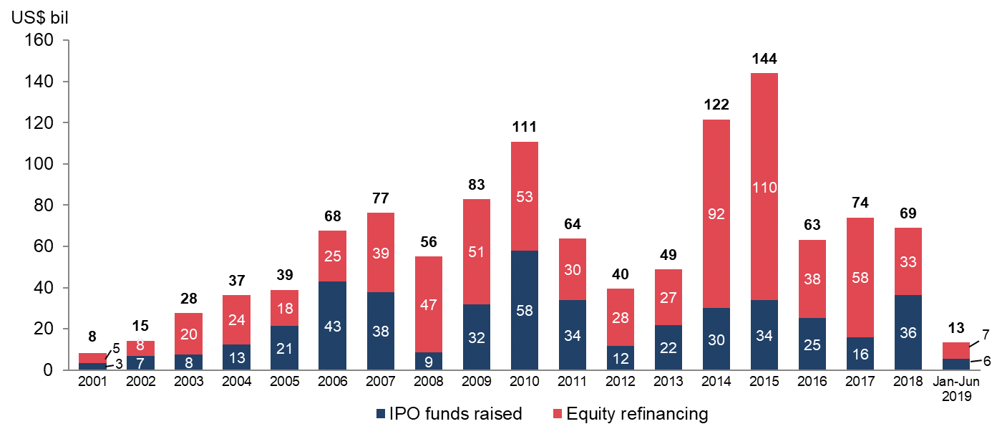
Figure 1: IPO funds raised and equity refinancing of listed companies at the HKEx (2001 - Jun 2019)
Source of information: HKEx

Slide 36
Financial Reporting and International M&As
* Theoretical research demonstrates that information asymmetries between prospective targets and acquiring firms constrain merger and acquisitions (M&As) activity.
* Financial reporting is intended to reduce information asymmetries by producing financial information useful for resource allocation decisions.

Slide 37
Financial Reporting and International M&As
* Research indicates that international financial reporting, specifically reporting under U.S. Generally Accepted Accounting Principles or International Financial Reporting Standards, results in more transparent financial information relative to other country-specific standards.

Slide 38
Financial Reporting and International M&As
* A thorough and objective review of the financial statements of an acquisition or merger candidate is an essential component of open market transactions.
* This includes both historical financial statements, forecast operating results (where they exist), and the
supporting notes and schedules thereto.

Slide 39
Financial Reporting and International M&As
* The focus of the analysis should be on the determinants of equity value, including the amount and timing of prospective discretionary cash flows, the level of risk involved, the existence of redundant assets, and the amount of interest bearing debt (and equivalents) outstanding

Slide 40
Financial Reporting and International M&As
* It is important to determine whether any hidden trade liabilities exist that serve to reduce the underlying net operating assets of the target company, and accordingly reduces the value and price that would be paid for its shares.

Slide 41
Case Studies
For effective teaching and learning purpose, all the cases are presented in Chinese

Slide 42
END
Thank You!

